Slide 1
Investigation of relations between unhealthy factors, overworking and cancer in Victoria
Bohan Yang
10/09/2018

Slide 2
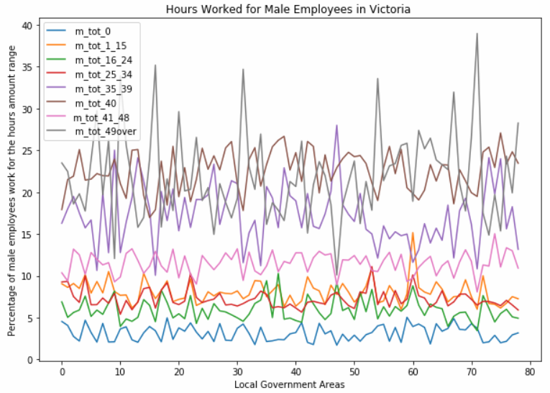
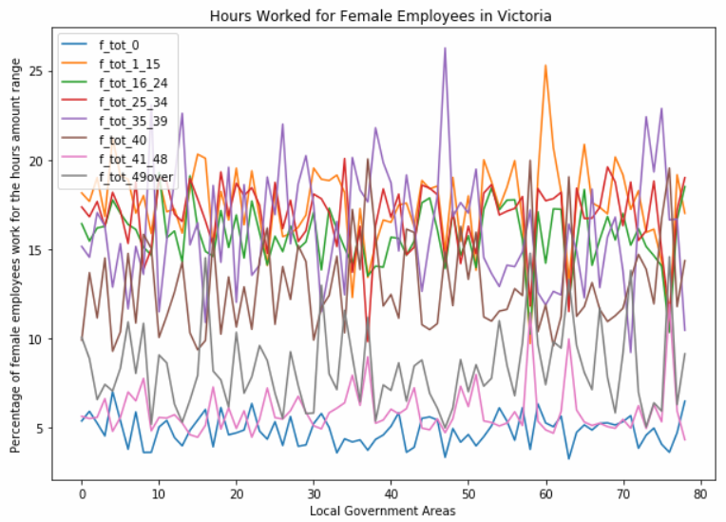
Male Employees in Victoria has large percentage for working more than 49 hours a week
Necessary to investigate if overworking is bad for health for male
Female Employees in Victoria has moderate and reasonable working hours Data from: LGA-G58a_Occupation_by_Hours_Worked_by_Sex-Census_2016.csv (Aurin)

Slide 3
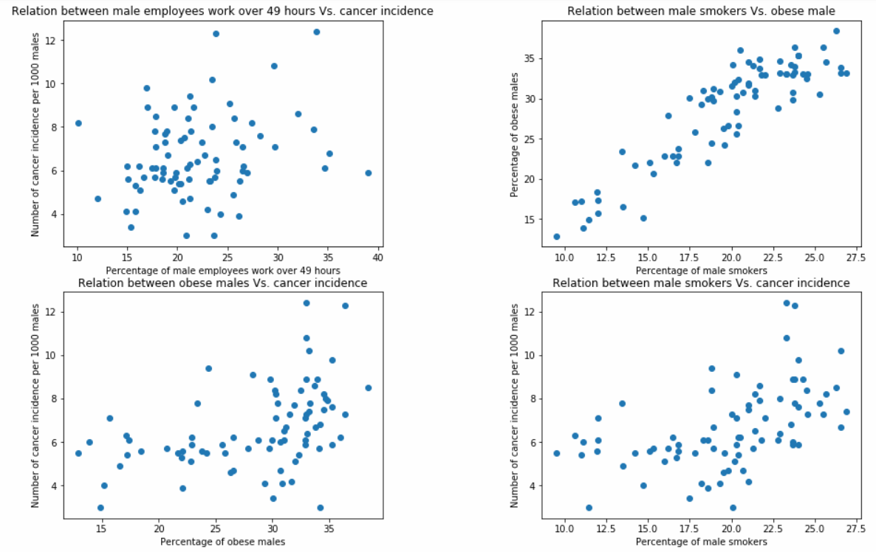
Relations between pairs of attributes
Strongest positive relation is between smokers and obese males
No obvious relation between overworking and cancer
Moderate positive relation between obese or smoking and cancer
Data from: LGA15_Adults_Health_Risk_Factor_Estimates_-_2014-2015.csv (Aurin)
Local_Government_Area__LGA__profiles_data_2015_for_VIC.csv (Aurin)

Slide 4
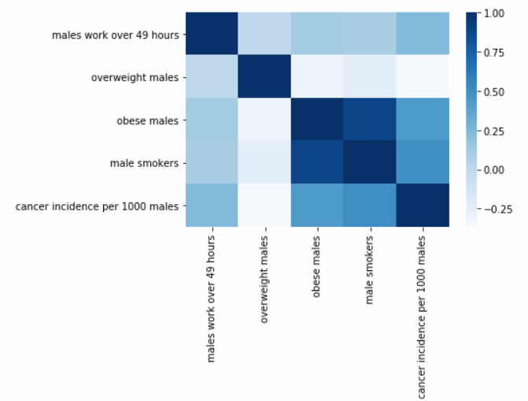
Heatmap for correlation coefficients for male data
Smoking and obesity both have around 0.5 correlation coefficients with cancer incidence, implying a noticeable positive relation
Working for more than 49 hours a week also has a small positive relation with cancer incidence for males in Victoria
Obesity and smoking have the strongest positive relation over all attributes

Slide 5
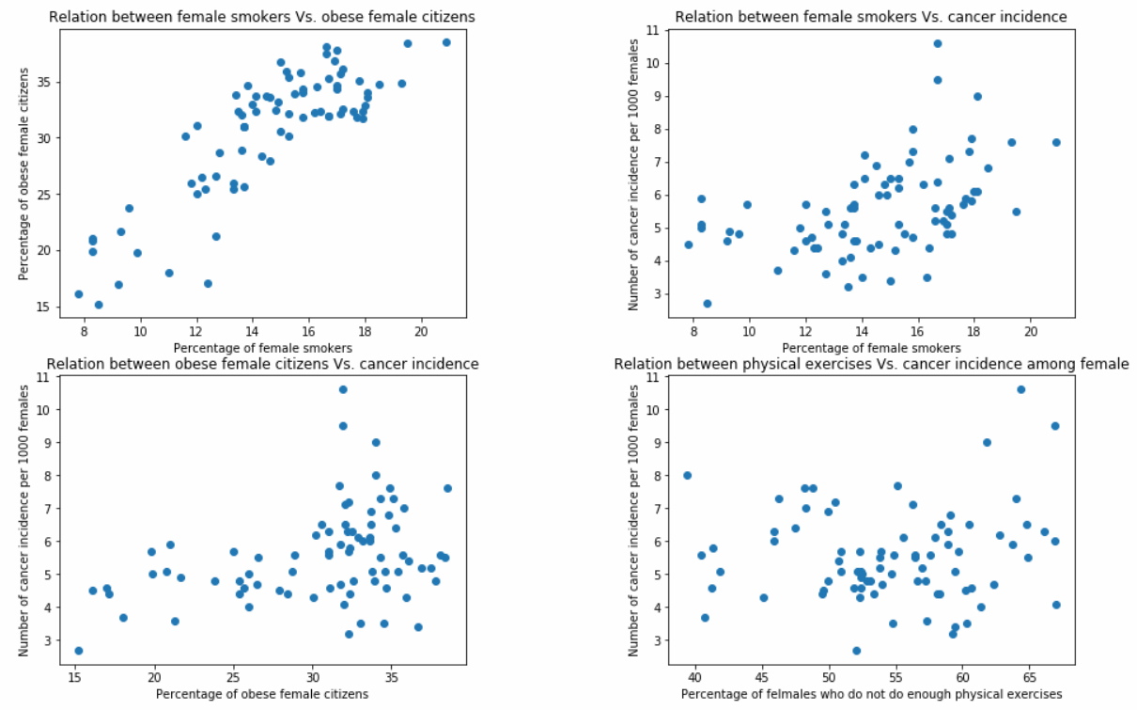
Relations between pairs of attributes
Strongest positive relation is between smokers and obese, same as males
Moderate positive relation between obese or smoking and cancer
Replaced overworking with physical exercises since overworking females take small percentage
Data from: LGA15_Adults_Health_Risk_Factor_Estimates_-_2014-2015.csv (Aurin)
Local_Government_Area__LGA__profiles_data_2015_for_VIC.csv (Aurin)

Slide 6
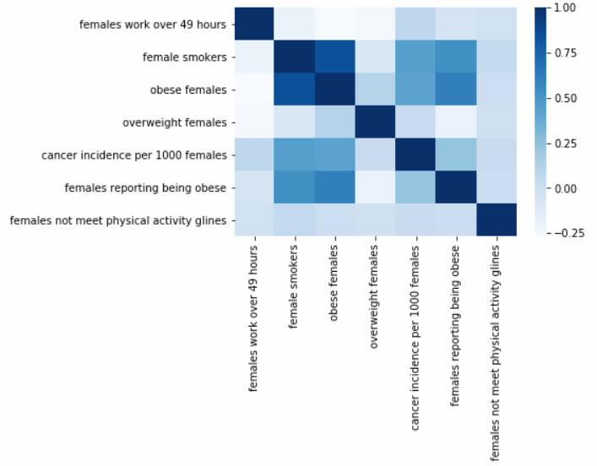
Heatmap for correlation coefficients for female data
Smoking and obesity both have around 0.3 correlation coefficients with cancer incidence, implying a positive relation
Both overworking and not doing enough exercise have little relation with cancer incidence for females
Obesity and smoking also have the strongest positive relation over all attributes
Female cancer incidence greater than 0.5% in LGAs prediction using K-NN:
Train accuracy: 79.37 %
Test accuracy: 68.75 %

Slide 7
The correlation coefficients between cancer incidence, risky alcohol consumption and overworking
 | Cancer incidence Per 1000 population | Risky alcohol consumption percentage | Work over 49 hours per week population percentage
Cancer incidence Per 1000 population | 1.000000 | 0.564316 | 0.235386
Risky alcohol consumption percentage | 0.564316 | 1.000000 | 0.453219
Work over 49 hours per week population percentage | 0.235386 | 0.453219 | 1.000000

Slide 8
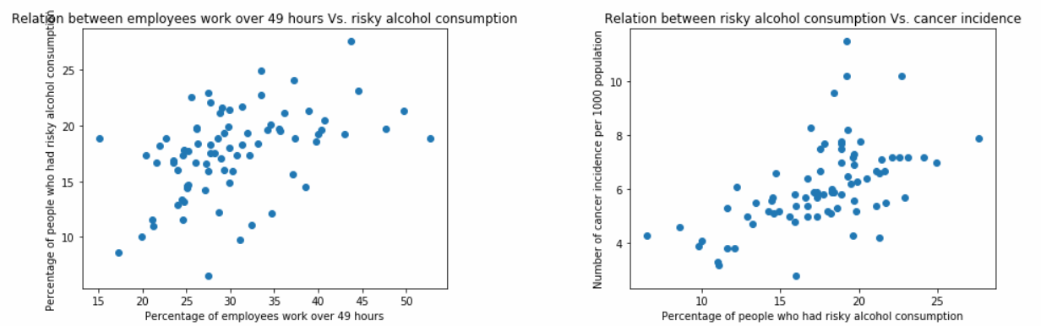
The relations between overworking, risky alcohol consumption and cancer
Risky alcohol consumption and cancer incidence have positive relation in Victoria
Overworking employees have better chance of taking too much alcohol
Overworking could indirectly influence cancer incidence

